Slide 1
Middle- and High-School Curricula for Music Technology Lessons With and Without Artificially Intelligent Tools
From the Concerts with Humans and Artificial Intelligence (CHAI) project: https://chai-music.glitch.me
v1.2 Jan 2025
Authors: Raina Murnak, Amanda Pasler, Eli Yaroch, Ryan Baker, Spencer Soule, Aditya Jeganath K., Jack Reilly, Lívia de Moraes,
Taylor Wright, Chris Bennett, and Tom Collins
Creative Commons Attribution (CC BY)

Slide 2
Contents
Introduction… p.1
Empty lesson plan for your repurposing… p.2
Music Technology Lessons With AI… pp.3–9; W_A–W_G
Music Technology Lessons Without AI… pp.10–16; N_A–N_G
Change log… p.17

Slide 3
Introduction
At the Frost School of Music, we utilize our Experiential Music CurriculumTM, which places doing at the center of learning. The following lesson plans are developed on this premise – that a good way to gain understanding of and fluency in AI tools for music analysis and creation is to be exposed to using such tools.
These curricula are a product of research supported by a University Laboratory for Integrative Knowledge (U-LINK) grant at the University of Miami.
The funded project is called Concerts with Humans and Artificial Intelligence (CHAI): https://chai-music.glitch.me
The authors are faculty professors, and students at undergraduate and graduate levels, who developed the materials collaboratively beginning April 2024.
The materials were used as part of the Shalala MusicReach Summer Institute June—August 2024. We conducted a scientific study investigating how integration of AI into the music technology curriculum impacts children’s self-efficacy and positive/negative affect. If you make use of these curricula, please cite the corresponding paper:
Collins, T., Murnak, R., & Bennett, C. (under review). “The kids are alright: Investigating the impact on children of integrating artificial intelligence into the music technology curriculum”
We found that AI integration does not have a notable effect on children’s self-efficacy or emotional well-being; moreover, we observe strong signs of their enthusiasm. Additional studies are needed to validate these results, but these initial findings suggest that middle- and high-school children are emotionally prepared for -- and positively inclined toward — the integration of AI into music curricula.
Where possible, we use free software in the form of web services, downloadable applications, and plugins. The pace of change in AI (for music) is fast. We note that Ableton Live Lite is a solid digital audio workstation (DAW) with downloads for macOS and Windows. You are welcome to tell us if any links are dead in the following lesson plans, or free initial use of certain tools is no longer possible.
Generally, if you have questions about integrating the following lesson plans into your own teaching, we are happy to answer them at tom.collins@miami.edu or r.murnak@umiami.edu.
If you use one or more of the lesson plans, you are also welcome to tell us how it went!
Tom & Raina

Slide 4
Lesson [identifier]
Delete one x!
x
x
Delete one circle!
1
Tue Jun 11th
2-3 pm
Intro class
For this intro class, the With AI/No AI distinction is not relevant; neither particularly is MS/HS.
To introduce the program to the students, get to know them, and start teaching the basic lingo and topics of music technology.
No special tools needed, mostly getting to know students
Introduce students (name, preferred pronouns, musical interests)
Will also have a funny question to be determined.
Code of conduct explanation
Explanation that Creative Studio may have footfall from UM students.
Time-zero questionnaire
Going over plan for semester.
Music tech lingo

Slide 5
Lesson W_A
1
Tue Jun 11th
2-3 pm
Intro class
For this intro class, the With AI/No AI distinction is not relevant; neither particularly is MS/HS.
To introduce the program to the students, get to know them, and start teaching the basic lingo and topics of music technology.
No special tools needed, mostly getting to know students.
Introduce students (name, preferred pronouns, musical interests)
Will also have a funny question to be determined.
Code of conduct explanation
Explanation that Creative Studio may have footfall from UM students.
Time-zero questionnaire
Going over plan for semester.
Music tech lingo

Slide 6
Lesson W_B
x
1
Thu Jun 13th
2-3 pm
Stem splitting
Pre-download some music onto classroom computers.
Learn meaning of the term “stem”.
Learn how stem splitters can be used to “hear inside” as well as remix songs.
Splitter (https://splitter.ai)
Ripple – Music Creation Tool (available on the App Store)
Listen to a song; listen to a remix of the song.
Discuss with students how remixes are made.
Discussion of aspects such as tempo and key (more in-depth for HS)
For HS only, discussion of sampling, including a demo of sampling
[The above steps should all be complete by ~20 mins.]
Use Splitter or Ripple to demonstrate stem splitting for two audio files of choice on the classroom computers.
Take the splits and use them to try to make a remix.
Share back initial results.

Slide 7
Lesson W_C
x
2
Tue Jun 18th
2-3 pm
Extending MIDI in Ableton Live
Ableton Live and Magenta Studio need to be installed prior to class.
Introduce Ableton Live’s Session View v Arrangement View.
Use AI to build upon existing melodies or drum tracks.
Ableton Live (https://www.ableton.com/en/live)
Magenta Studio (https://magenta.tensorflow.org/studio)
Make sure students are set up on Live’s Session View and help them get familiar with how the DAW works, absent any AI.
Get Magenta Studio plugin set up on a melody or drum track.
  Instructor to do a live demo of how it works.
  Can use external MIDI controller for added emphasis on the live aspect.
Let the students experiment with the software to produce their own tracks.
If they experimented with AI-extending/altering a melody, now switch to do similar but with a drum track, and vice versa.
Share back if time allows.

Slide 8
Lesson W_D
x
2
Thu Jun 20th
2-3 pm
Vocal synthesis and emulation
If students do not have vocals to use, they will be provided with examples from which to choose.
Explore the task of text-to-speech for rap generation.
Learn how to turn one voice into another (voice emulation or cloning) utilizing software.
Kits AI (https://www.kits.ai/tools/text-to-speech)
Musicfy (https://create.musicfy.lol/create/voice)
Present the topic and the technology.
Explain the upcoming activity and expectations. Answer any student questions.
Students will generate a rap using Kits AI.
Discuss and share.
Students will emulate an artist in Musicfy using either their own vocal or one of the files provided.
Discuss the ethical and legal implications of voice emulation and cloning. Compare Kits AI and Musicfy in these regards.

Slide 9
Lesson W_E
x
3
Tue Jun 25th
2-3 pm
MIDI beat-making
Cocreate does not require a DAW, but does require an account and email via which to receive results.
To teach the basics of Musical Instrument Digital Interface (MIDI).
How to create beats from scratch.
Hip hop beats from MAIA Markov on Cocreate (https://cocreate.glitch.me)
SOUNDRAW (https://soundraw.io) if budget allows.
Use DAW of preference.
Brief lesson on MIDI (what it means, how it works, where it came from, why it is used).
Assign pairs and load Cocreate.
Instructor demonstrates generation of a hip hop beat using MAIA Markov on Cocreate.
Have students try for themselves.
Introduce a competitive aspect if you like, such as a beat-making competition where classmates vote for their favorite generated (+ human-altered) beat.

Slide 10
Lesson W_F
x
3
Thu Jun 27th
2-3 pm
Text-to-audio for song creation
An instrumental-only text-to-audio model is MusicGen, available via Hugging Face or Text to Sample.
Build upon what was learned in the MIDI lesson.
Generate songs with AI, but dive deep into the generated structures.
Find what there is to like and dislike about AI-generated songs.
Suno (https://suno.com)
Ripple – Music Creation Tool (available on the App Store)
Boomy (https://boomy.com)
Introduce and present on song form/structure, such as “verse”, “chorus”, etc.
Listen to a song. Have students raise their hands to indicate awareness of transitions from verses to choruses.
Have students try one of the AI song generation tools listed above.
Share back and have them explain what they like and dislike about the AI-generated songs.
Have students select one of the generated songs, then pair up to discuss its structure.
If time allows, import the generated song into a DAW, and allude to activities that might come next, such as:
  Adding lyrics/vocals to an instrumental-only generated track.
  Using a stem splitter to isolate different components and/or sample from the generated track.

Slide 11
Lesson W_G
x
4
Tue Jul 2nd
2-3 pm
AI in mixing and mastering
Provide a DAW session to students with some unmixed stems.
Teach the basics of mixing and editing.
Use AI-powered mixing tools to demonstrate how some tasks can be automated.
iZotope Neutron, Ozone, and Neoverb (https://www.izotope.com/en/products.html)
Logic’s Mastering Assistant: https://support.apple.com/en-us/108294
Introduce why mixing is necessary, motivated by listening to an example of pre-mix v post-mix v post-master.
Use Neutron or another AI channel strip on a track to show how effects change a sound. If possible, use the analysis features to visualize the changes.
Use Neoverb or another AI reverb to show how reverb affects a sound.
Students experiment with Neutron, Neoverb, or other effects/mixing plugins in the provided DAW session.

Slide 12
Lesson N_A
1
Tue Jun 11th
2-3 pm
Intro class
For this intro class, the With AI/No AI distinction is not relevant; neither particularly is MS/HS.
To introduce the program to the students, get to know them, and start teaching the basic lingo and topics of music technology.
No special tools needed, mostly getting to know students.
Introduce students (name, preferred pronouns, musical interests)
Will also have a funny question to be determined.
Code of conduct explanation
Explanation that Creative Studio may have footfall from UM students.
Time-zero questionnaire
Going over plan for semester.
Music tech lingo

Slide 13
Lesson N_B
More work required here to finish PDF -> PPTX conversion of lesson plans.
x
1
Thu Jun 13th
2-3 pm
Stems
Low-stakes, fun first audio lesson after intro. Download some multi-tracks in advance (see link below).
Learn meaning of the term “stem”.
What are stems, and how they can be used in sampling and mixing.
Cambridge Multitrack Library (https://cambridge-mt.com/ms/mtk)
Introductory slideshow

Slide 14
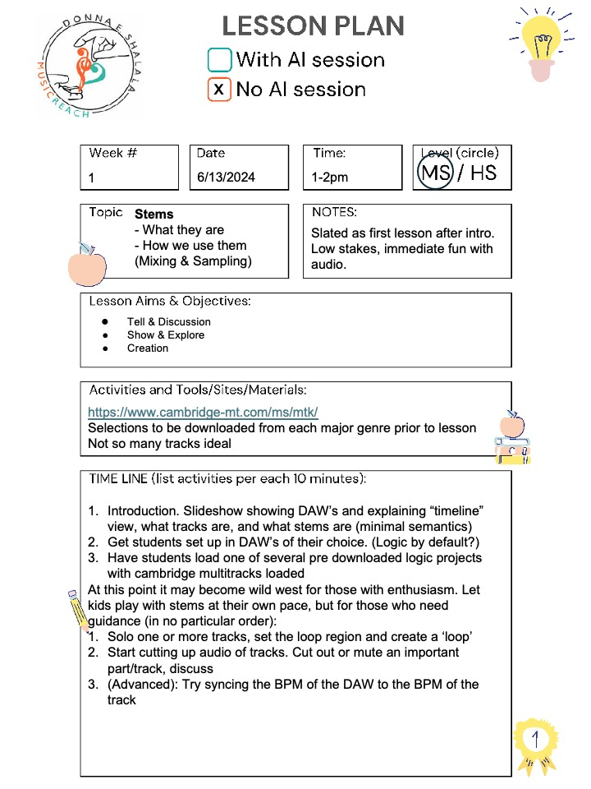
Lesson N_B orig

Slide 15
Lesson N_C
x
2
Tue Jun 18th
2-3 pm
Sound design
Ableton Live and Magenta Studio need to be installed prior to class.
Introduce Ableton Live’s Session View v Arrangement View.
Use AI to build upon existing melodies or drum tracks.
Ableton Live (https://www.ableton.com/en/live)
Magenta Studio (https://magenta.tensorflow.org/studio)
s

Slide 16
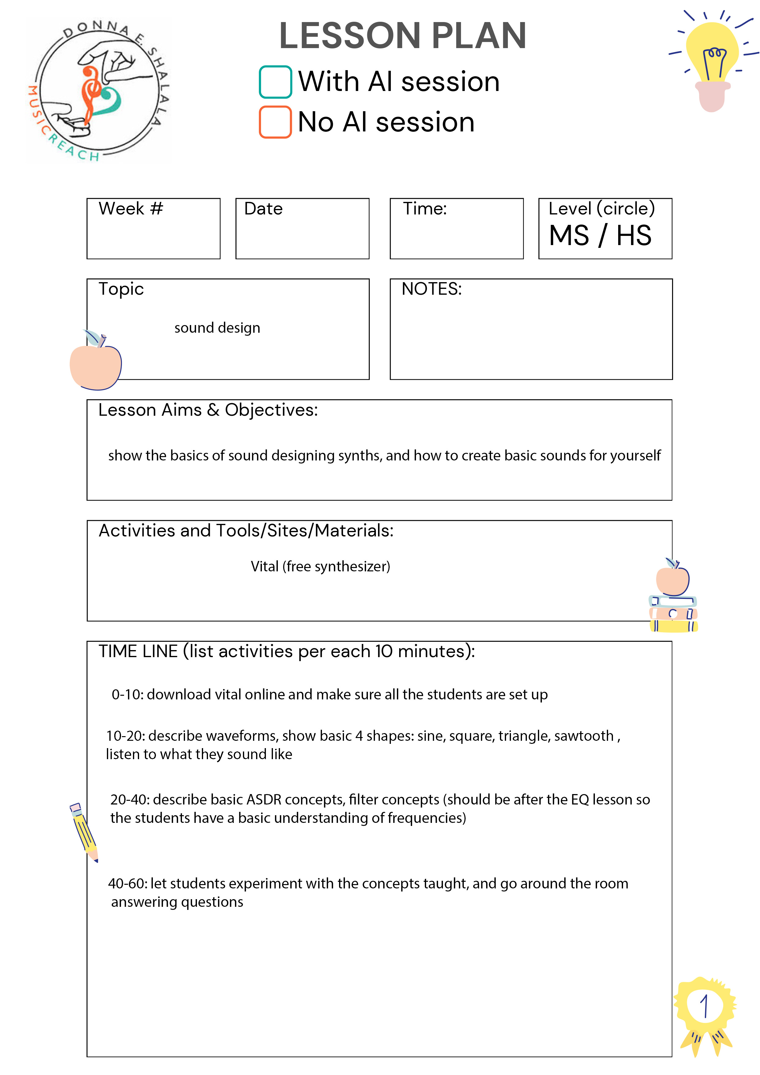
Lesson N_C orig

Slide 17
Lesson N_D
x
2
Thu Jun 20th
2-3 pm
Vocal synthesis and emulation
If students do not have vocals to use, they will be provided with examples from which to choose.
Explore the task of text-to-speech for rap generation.
Learn how to turn one voice into another (voice emulation or cloning) utilizing software.
Kits AI (https://www.kits.ai/tools/text-to-speech)
Musicfy (https://create.musicfy.lol/create/voice)
s

Slide 18
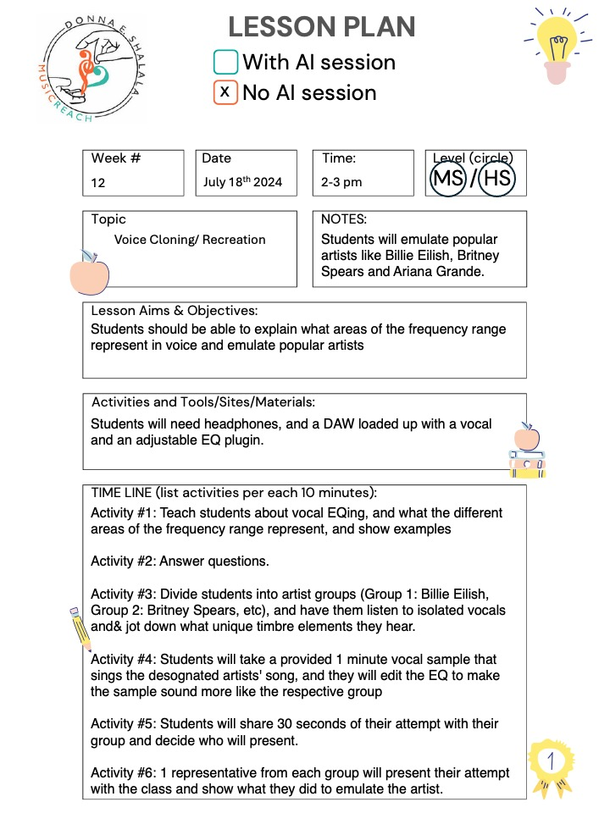
Lesson N_D orig

Slide 19
Lesson N_E
x
3
Tue Jun 25th
2-3 pm
MIDI beat-making
Cocreate does not require a DAW, but does require an account and email via which to receive results.
To teach the basics of Musical Instrument Digital Interface (MIDI).
How to create beats from scratch.
Hip hop beats from MAIA Markov on Cocreate (https://cocreate.glitch.me)
SOUNDRAW (https://soundraw.io) if budget allows.
Use DAW of preference.
s

Slide 20
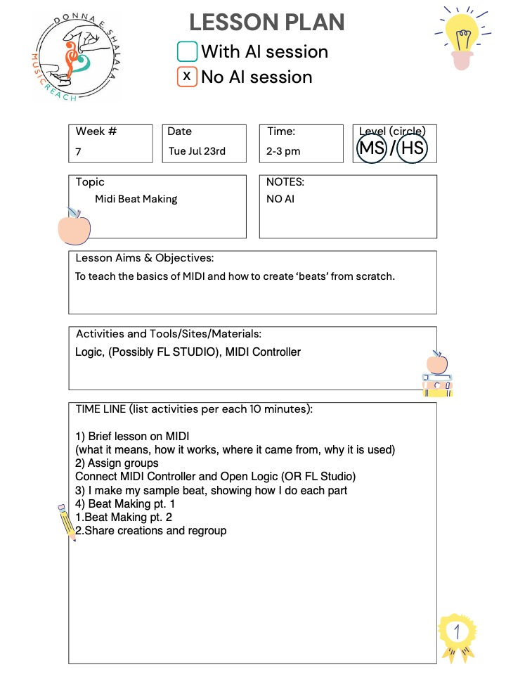
Lesson N_E orig

Slide 21
Lesson N_F
x
3
Thu Jun 27th
2-3 pm
Song creation
An instrumental-only text-to-audio model is MusicGen, available via Hugging Face or Text to Sample.
Build upon what was learned in the MIDI lesson.
Generate songs with AI, but dive deep into the generated structures.
Find what there is to like and dislike about AI-generated songs.
Suno (https://suno.com)
Ripple – Music Creation Tool (available on the App Store)
Boomy (https://boomy.com)
s

Slide 22
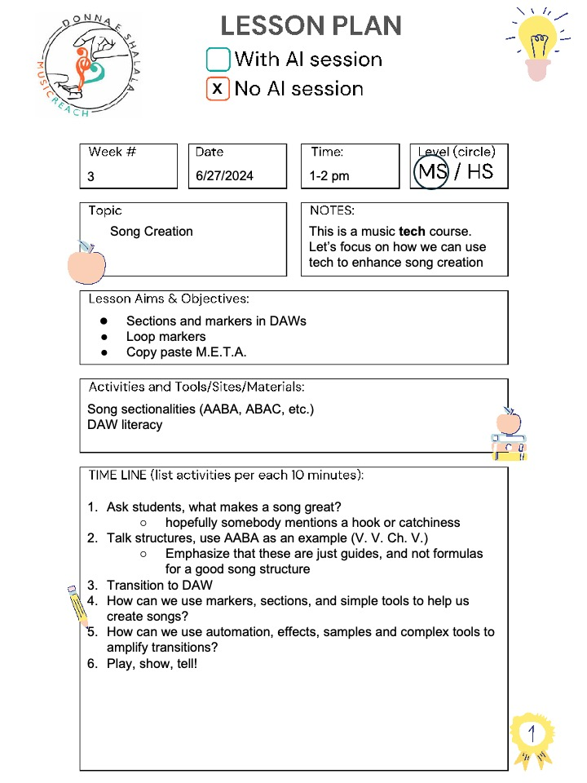
Lesson N_F orig

Slide 23
Lesson N_G
x
4
Tue Jul 2nd
2-3 pm
Mixing and mastering
Provide a DAW session to students with some unmixed stems.
Teach the basics of mixing and editing.
Use AI-powered mixing tools to demonstrate how some tasks can be automated.
iZotope Neutron, Ozone, and Neoverb (https://www.izotope.com/en/products.html)
Logic’s Mastering Assistant: https://support.apple.com/en-us/108294
Introduce why mixing is necessary, motivated by listening to an example of pre-mix v post-mix v post-master.
Use Neutron or another AI channel strip on a track to show how effects change a sound. If possible, use the analysis features to visualize the changes.
Use Neoverb or another AI reverb to show how reverb affects a sound.
Students experiment with Neutron, Neoverb, or other effects/mixing plugins in the provided DAW session.

Slide 24
Lesson N_G orig

Slide 25
Change log
v1.1 Initial release
v1.2 Converted some PDF lesson plans to PPTX for ease of adaption by instructors. Added some material and corrected some wording in the Introduction.

